Slide 1
4457 Project Presentation
BY Jameel Kaba, Pedro Ortega, Pearson Radu

Slide 2
Definition and outline of problem
Addressing QoS monitoring problems
Main plan : to develop prototype QoS monitor app
Will analyze and sort network information
Consider two points on a network

Slide 3
Why Is It Important / motivation
This problem is important to network technology
It will allow us to obtain more accurate information on how constant and stable flow of networks that are available by ISPs to the public
The need for developing connection solutions and persistence in data transfer
Motivation:
As technology becomes more integrated in society, aspects such as internet availability become vital for business and people to stay connected
Using our solution, we hope to help ISP find areas in their networks that require immediate attention

Slide 4
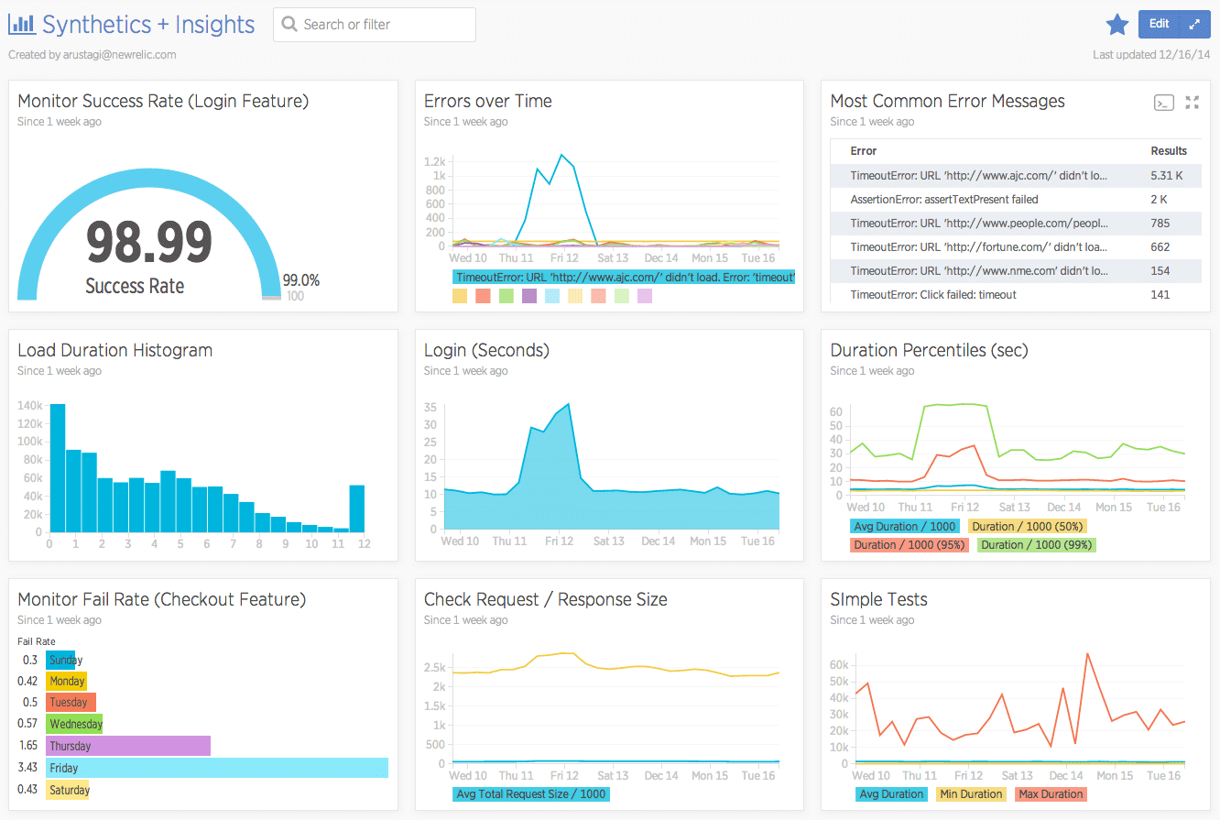
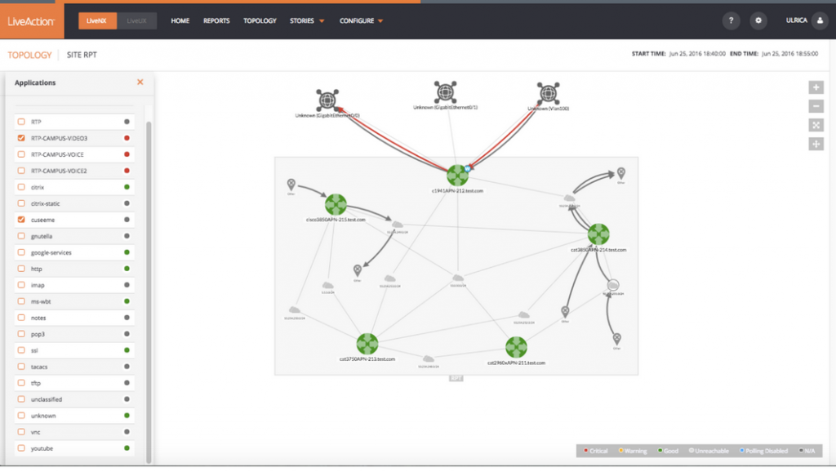
Existing Solutions
Companies run and maintain different software that is similar to ours in order to provide proactive QOS monitoring.
Ex:
Synthetics By New Relic
LiveNX by LiveAction

Slide 5
Existing Solutions (2)
1) Synthetics by New Relic, provides the service of QoS monitoring specifically for small companies and applications, showing their performance and factors as the flow of data, packet loss, load times and more using graphs, and charts
2) LiveNX by LiveAction, provides proactive QoS monitoring showing a network topology with status between endpoints while allowing the user to analyze the path to see where problems may be or where they may arise. Users can also preview CLI changes to see the effect it will have on the network topology before sending it to the router.

Slide 6
New Relics Synthetics v. Our program
Different:
Synthetics is more focused on websites, so it has features that allow users to see which content types are being loading and how the average load duration and payload size impact performance.
Synthetics allows for simulated browser interactions from a browser script that is written with a modified version of JavaScript.
Synthetics uses charts and graphs to display the information while we use a network topology.
Similar:
Provides information such as network status. ( both show if its at good standing, slow, or undesirable)
View detailed metrics to see determine where the issue may possibly arise from. ( throughput, link utilization, etc…)

Slide 7
LiveAction LiveNX v. Our Program
Different:
LiveNX allows the user to preview any changes made to the router by simulating the change
LiveNX allows the user to generate fake network traffic to see the effect it will have on the network, while we use a predetermined set of data
Similar:
Network topology (map) that shows QoS parameters and the network status.
User can see the network status and QoS parameters for a path on the topology.

Slide 8
Our Solution / How it was designed
Our solution is a Java Program that provides proactive QOS monitoring for a path which is based off the given parameters, considering a shortest path between two endpoints via an internet source
It was designed by answering two questions:
How to draw topology and show information?
By using open source software
How to find the path in a topology?
Using a shortest path algorithm

Slide 9
challenges
Time
Other classes, work and additional activities
Caused delays
coding / bugs
Tricky to handle JUNG
Testing and deciding on approach
Trying to find information and ranges on metrics used

Slide 10
Step by step description of how software/solution was developed
Description of how it was developed
Altered the basic JUNG software to draw a network topology
Created a Shortest path algorithm to be able to find the shortest path between 2 nodes via an internet source
Altered JUNG to highlight path taken
Included Network parameters and modified JUNG to display the network status along the path
Altered JUNG so that network parameters are displayed by selecting a point along the path

Slide 11
How Our Solution Works
The program returns a network topology that contains the network status along a path between two endpoints.
The network topology will be drawn by using JUNG which is an open-source software
This path is determined by two endpoints provided by the user

Slide 12
How Our Solution Works (2)
The User provides two endpoints
The program will determine the best possible path between endpoints
The program will try to find the shortest path to go from the first endpoint to an internet source, and from an internet source to the second endpoint
The program will return a network topology that contains the network status along this path.
Metrics can be viewed by selecting a point along the path

Slide 13
Demo
As previously mentioned we are using JUNG to draw our network topology.
Following presentation, demo of our program at this point.
Metrics to be considered
Packet Loss
Throughput
Latency
Number of Hops
Link Utilization

Slide 14
Data Ranges
Metric | Good | Acceptable | Bad
Packet Loss | < 1% | 1% - 5% | 5% - 10%
Throughput | <50% Link Speed | 50% - 80% | 80%+
Latency | 0ms – 80ms | 80ms – 170ms | 170ms+
Link Utilization | < 40% | 40% - 70% | 70%+
TCP Port | 22 (SFTP)

Slide 15
Overview of Our Proposed Idea to Address the Problem
Our idea will help solve the problem by analyzing data flow from 2 end points and will be displayed to the user using a network topology diagram.
Showing all of the existing points on the network and their connections
Showing status along the path between end points
Showing connectivity information between selected points
Packet data, throughput, etc…

Slide 16
Testing and results
What we expect to see
Test: The network topology displays on screen. PASS
Test: Metrics displayed when a node from the path is selected. PASS
Note: issues with calculations, and how percentages are displayed
Test: Path color changes between edges based on the network status . PASS
Test: User can select two endpoints and the program will return the path, metrics for selected points, and path status for the path. PASS

Slide 17
Possible improvements
Comparative testing with a known method or solution ( use another company software)
Testing our software on an actual network as opposed to using simulated data and a predetermined network topology
Spend time working with other open source drawing software to make the program look nicer and cleaner

Slide 18
Wishlist
Some of the features we wanted to implement, but ran out of time to implement them are as followed
Modify the shortest path algorithm to consider the network parameters when finding the shortest path
Allowing the User to choose their own path
Ensuring that calculations are correct and that steps/equations used are displayed in the program.

Slide 19
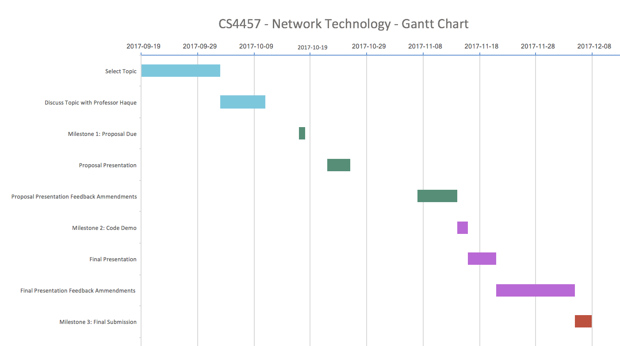
Timeline

Slide 20
Thank you! Any questions?

